Slide 1
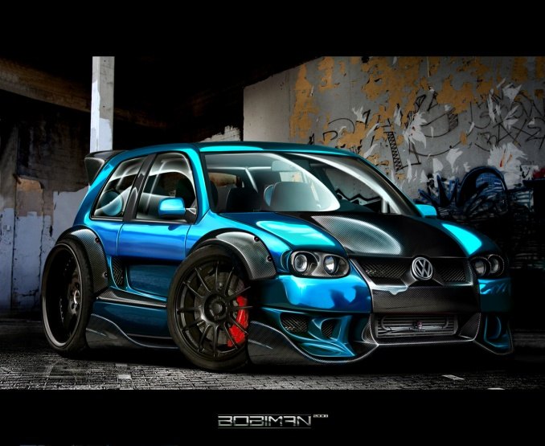
CAR WASH PROJECT

Slide 2
TABLE OF CONTENTS.
Business strategy and target (see advert for price information) | Page 1
Voting for the business | Page 2
Organisation chart | Page 3
Location and schedule | Page 4
Proposed budget | Page 5
Price list | Page 6
Appendices.
Advertisement | Page 7
Booking form | Page 8

Slide 3
BUSINESS STARTEGY
Year 10 EDEXCEL business is focus on provision of the car wash services for the teachers and citizen of our school at affordable price.
BUSINESS TARGET:
Teachers in our school.
Staff.
Other fellow students.
Page 1

Slide 4
ORGANISATION CHART
MANAGER ALAFIQ
PROJECT LEADER
ALAFIQ
CLARK K.ANUAR
PROJECT LEADER
ALAFIQ
BO: (YUSRIN
)
FC.MUHOMED
FC.ERDIANA
OPERATION
YUSRIN
FINANCE
MUHAMMAD
ADMINISTRATION
ERDIANA
Page 3

Slide 5
ORGANISATION CHART
PROJECT LEADER
ALAFIQ
ASST.PROJECT LEADER
KHAIRUL ANUAR
FINANCE
MUHAMMAD
ADMINISTRATION
ERDIANA
OPERATION
YUSRIN &
AK RAMLEE
Page 3

Slide 6
LOCATION AND SCHEDULE
Location : Parking lot of SM PAP HJH RASHIDAH
SAADATUL BOLKIAH, LUMUT.
Schedule : Monday (Second and fourth week of the month)
Time : 10:00 am until 12:00pm
Period: 5/6/7/8.
Page 4

Slide 7
CAR WASH B$4.00 /B$5.00
AMAROLL $3.00
WINDOW CLEANING $3.00
Page 7

Slide 8
PROPOSED BUDGET
ITEMS | QUANTITY | PRICE B$
Buckets | 2 | 5.00
Sponges | 3 | 2.00
Clothes | 4 | 4.00
Car Shampoo | 1 | 4.50
Amarol / tyre cleaner | 1 | 4.00
Window cleaner | 1 | 2.50
Total Cost in B$ |  | 22.00
Page 5

Slide 9
SAMPLE OF BOOKING FORM
CUSTOMER’S NAME | DATE | TIME | CAR TYPE | REG.NO | SERVICE
Page 8

Slide 10
PRICE OF THE SERVICE PROVIDED
TYPES OF SERVICES | PRICE B$
CAR WASH
SALOON CAR | B$4.00
SUV/VAN | B$5.00
MOTORBIKE | B$3.00
TYRE SHINING | B$3.00
WINDOW CLEANING | B$3.00
Page 6

Slide 11
VOTING FOR THE BUSINESS
TYPES OF SERVICES | VOTE SCORE
CAR WASH | 5
CLASSROOM CLEANING SERVICES | 0
SELLING JUNK FOOD | I
BOOKMARK(CUSTOM MADE) | I
SELLING REPACK SWEATS | 4
SELLING ICE CREAM | 1
SELLING STATIONERIES | 0
Page 2

Slide 12
APPENDICES

